Slide 1
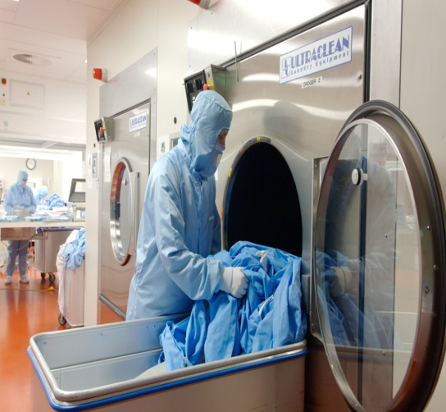
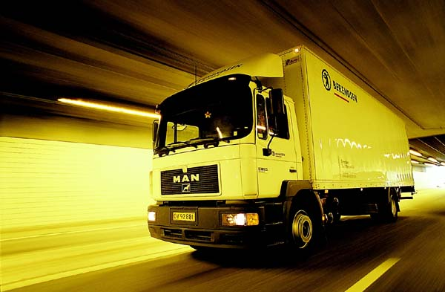
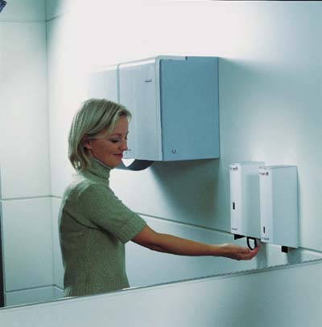
BERENDSEN TEXTILE SERVICE
Leading Service Excellence

Slide 2
Berendsen in Poland
1993/1995 - market researche, register of company in Poland
1996 - the first plant in Zukowo close to Gdansk
1997 - start of rental of garments, but focus on mats
1998 - operation in South of Poland
2000 - extending operations to Poznan
2001/2002 - extension of Żukowo plant
2005/2006 - new laundry in Katowice
2007 - New plant in Warsaw
2008 - New plant in Poznań
2009 - New plant in Wrocław, Central Warehouse in Reda

Slide 3
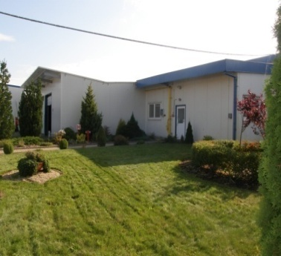
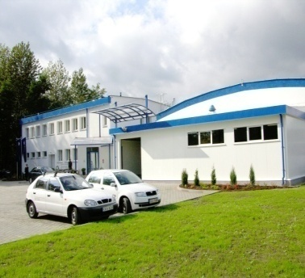
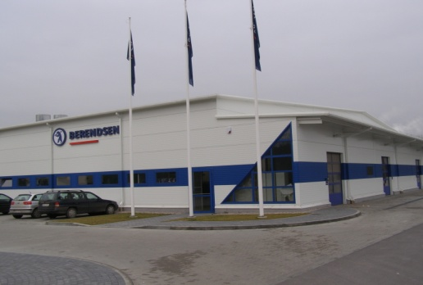
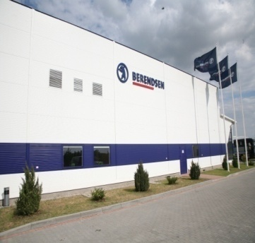
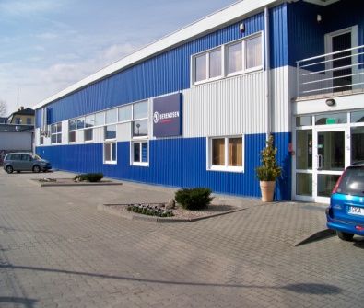
BTS Poland plants
Żukowo | Katowice | Warsaw | Poznan | Wroclaw | Reda Central Warehouse
1996/2002 | 2005/2006 | 2007 | 2008 | 2009 | 2009

Slide 4
MAP WITH LOCATIONS
GDN
Existing plants
Planned plants
POZ
Depos
WAW
LDZ
WRO
KTW
TAR

Slide 5
SYSTEM

Slide 6
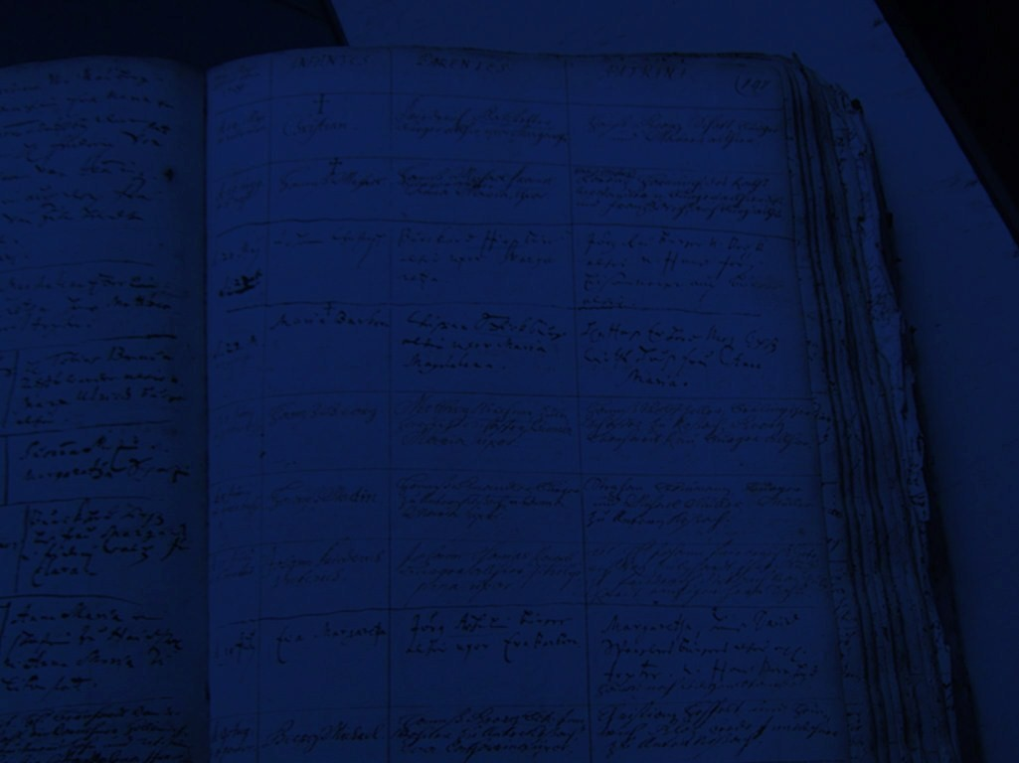
WELCOME
Reda
18-05-2011
Developed by Berendsen
Innovative supply chain solutions
Berendsen Textile Service

Slide 7
Flowchart customer order – order central warehouse
SOL Internet order
Order suggestion
Order to central stock
Customer order
Replacement order
SOL history
Berendsen Textile Service

Slide 8
Customer (customer service)
Customer service order
KAT
ZUK
POZ
WAW
WRO
Central
Warehouse
SOL history
Berendsen Textile Service

Slide 9
Flowchart customer order – order central warehouse
SOL Internet order
In stock Y/N
Order suggestion
Order to central stock
Purchase
Customer order
Replacement order
SOL history
Berendsen Textile Service

Slide 10
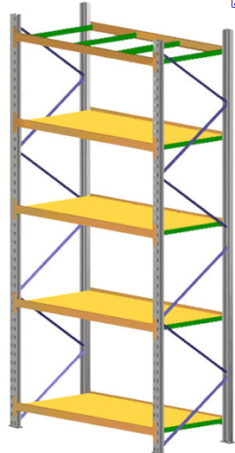
Supplier
Delivery
Work order
Purchase
Central
Warehouse
Verification
Stock level
Orders
ZUK
KAT
POZ
WAW
WRO
SOL history
Berendsen Textile Service

Slide 11
Flowchart customer order – order central warehouse
SOL Internet order
In stock Y/N
Order suggestion
Order to central stock
Purchase
Customer order
Replacement order
Central Order
Register (Online)
SOL history
Berendsen Textile Service

Slide 12
Flowchart customer order – order central warehouse
SOL Internet order
In stock Y/N
Order suggestion
Order to central stock
Purchase
Customer order
Replacement order
Central Order
Register (Online)
Deficiency report
Contract
Picking list
Delivery from supplier
Goods receiving at laundry
Delivery note
Local stock
Work order
Production
Control scan
Sorting
Prewash
Direct delivery
Delivery
to customer
SOL history
Berendsen Textile Service

Slide 13
In a traditional garment stock system the orders are placed for a certain quantity of garments necessary for the contract.
In SOL system orders are placed authomatically and system takes into consideration:
security level and actual consumption
consumption per week for the last 3 months (or last 2 years)
existing customers orders and purchase orders
delivery time from the supplier
any minimum quantities
SOL history
Berendsen Textile Service

Slide 14
Flowchart customer order – order central warehouse
SOL Internet order
In stock Y/N
Order suggestion
Order to central stock
Purchase
Customer order
Replacement order
Central Order
Register (Online)
Deficiency report
Contract
Picking list
Delivery from supplier
Goods receiving at laundry
Delivery note
Local stock
Work order
Production
Control scan
Sorting
Prewash
Direct delivery
Delivery
to customer
Service On Line
SOL history
Berendsen Textile Service

Slide 15
Service On Line
Developed on our customers demands
Unique solutions for the market
High data quality and control
System available 24 hours per day
Garment orders
Reports
Extra signals for garment, wearer
Contract information
Berendsen Textile Service

Slide 16
SOFTWARE DESIGN
Designed to handle large volumes with
maintained performance and security in real time!
Central
Warehouse
ONE instance for EACH country
SOL
Master
WEB SERVICES
ONE instance for EACH laundry
SOL history
Berendsen Textile Service

Slide 17
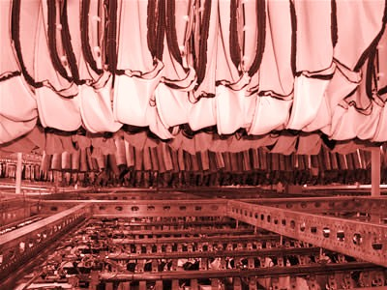
INTERNAL COMMUNICATION
SOL is the engine for several system
DATA WAREHOUSE
FINANCIAL SYSTEM
CONVEYOR SYSTEM
CENTRAL WAREHOUSE
CRM SYSTEM
Berendsen Textile Service

Slide 18
EXTERNAL COMMUNICATION
PRODUCT CATALOGUE
A powerful tool to be excellent on the market
THROUGH INTERNET
DRIVERS GPS
INVENTORY / LARGE ORDERS
UNIMAT
WORKWEAR
Berendsen Textile Service

